Slide 1
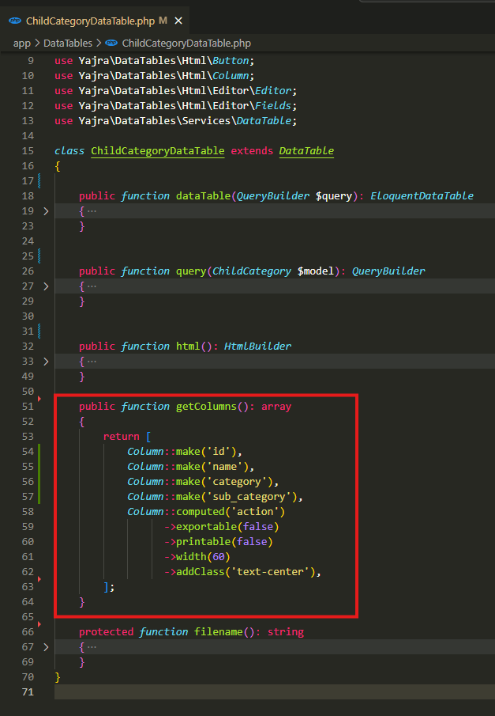
app\DataTables\ChildCategoryDataTable.php

Slide 2
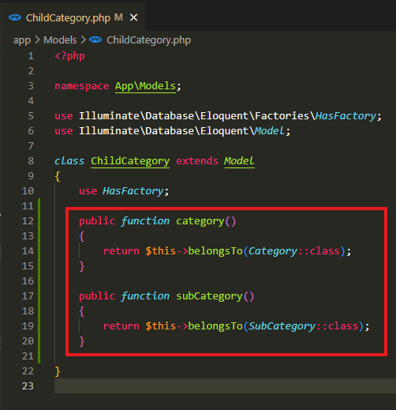
app\Models\ChildCategory.php

Slide 3
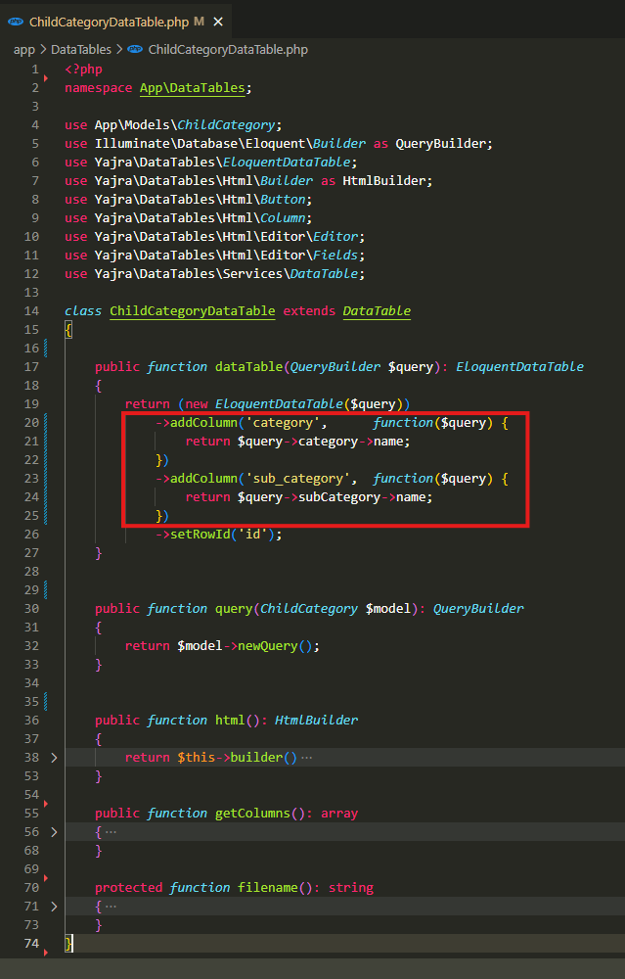
app\DataTables\ChildCategoryDataTable.php

Slide 4
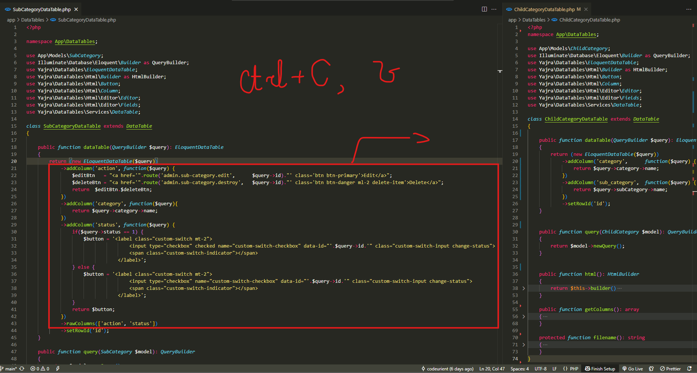
.

Slide 5
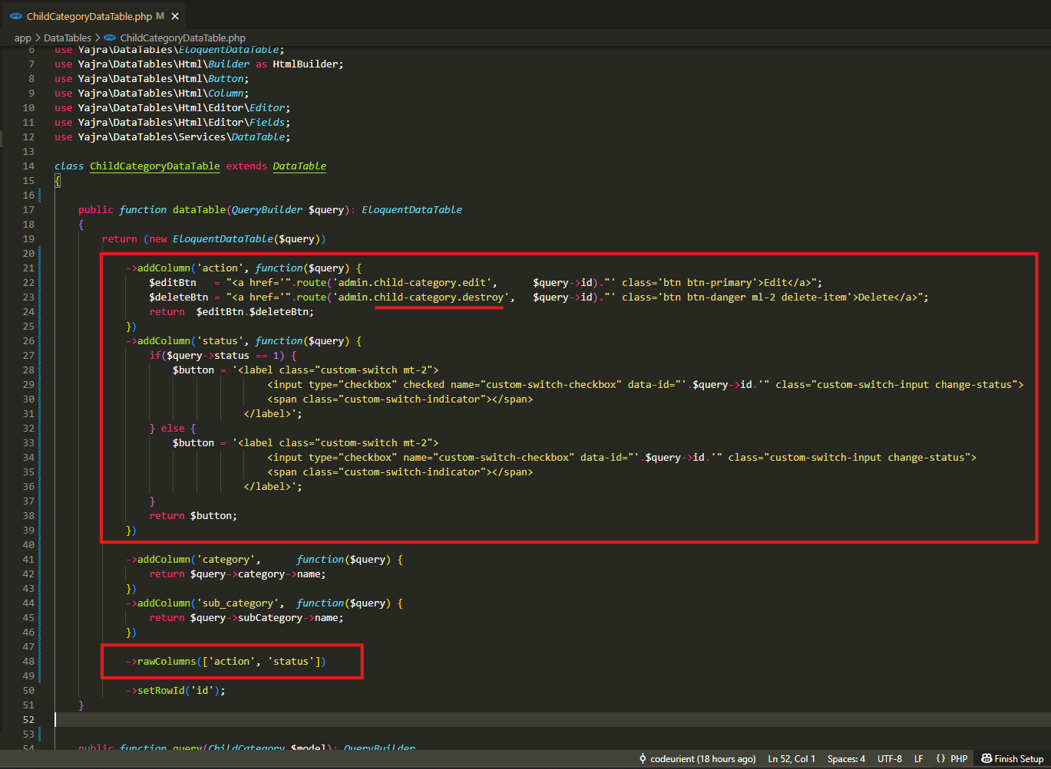
app\DataTables\ChildCategoryDataTable.php

Slide 6
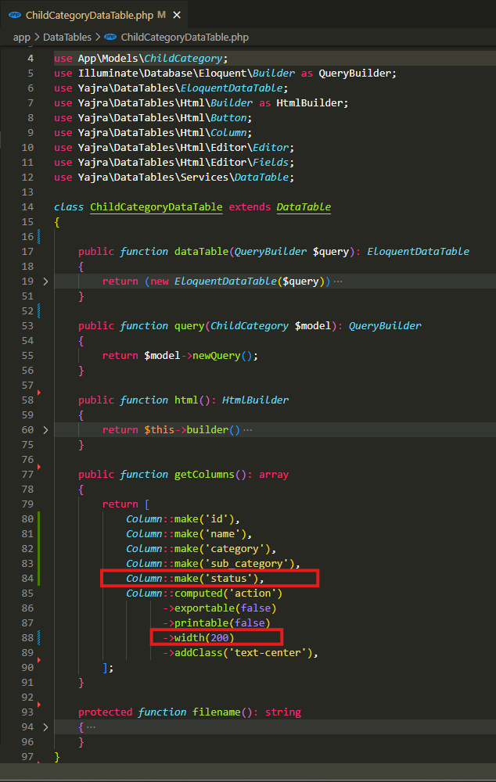
app\DataTables\ChildCategoryDataTable.php

Slide 7
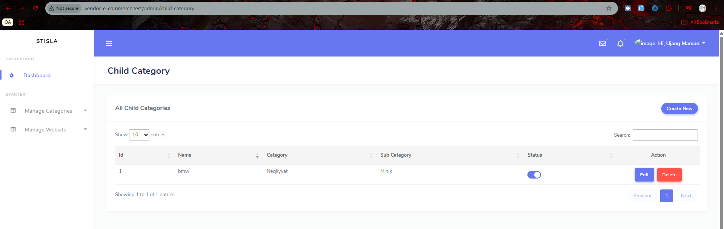
.

Slide 8
.

